Slide 1



MUSIC RECOMMENDATION SYSTEM
PRESENTED BY-
REETI AGARWAL – 23070122177
RIYA AGRAWAL – 23070122184
SAUMYA KUMAR- 23070122195
NIMITA JESTIN - 23070122259

Slide 2


INTRODUCTION
It may be exciting and difficult to discover new songs in the huge and constantly growing world of music that fit our personal tastes.
The "Personalised Music Recommendation System" project aims to simplify the process of choosing the perfect soundtrack by using data and algorithms.
This project offers a personalised music recommendation experience based on lyric recognition, ensuring that each user is greeted with tunes that suit their likes.

Slide 3

1. Data Collection
From Spotify, kaggle dataset and many more
Database containing name of songs with their artists and lyrics

Slide 4
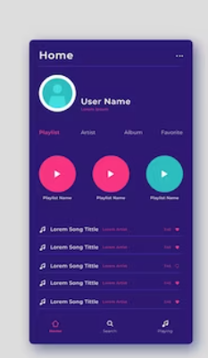
2. User Interface
Users can search songs by entering specific keywords
Users will be given several options too, like top 5 songs based on their similarity with other songs

Slide 5

3. Data Processing
After data collection, data would be cleaned and processed
Remove all the duplicates and spelling errors
Make a standardized system

Slide 6

Literature Survey
A decent music recommendation engine should be able to recognise user preferences automatically and create playlists that fit those choices.
Meanwhile, industry has a fantastic potential to gather users interested in music thanks to the advent of recommender systems.
The section talks about a content-based recommendation system that makes suggestions for products based on their attributes and how similar some parts are to other products.
According to their research, those who are very extraverted typically enjoy lively music, while people who are more agreeable and extraverted tend to prefer rhythmic and energetic music.

Slide 7
Literature
Survey
The link between music and its effects has been extensively studied in recent years in the fields of athletics, psychology, neurology, and music perception of how people behave. Without a question, music has always played a significant role in our lives, and we may now access it easily

Slide 8

Content-based Recommender Systems: State of the Art and Trends
The paper by Pasquale Lops, Marco de Gemmis, and Giovanni Semeraro
delves into several crucial aspects regarding content-based recommender systems and their challenges. Divided into three parts, it covers:
1.Introduction to Content-Based Recommender Systems
2. Review of State-of-the-Art Techniques
3. Future Research Directions and Trends

Slide 9
1. *Introduction to Content-Based Recommender Systems:*
Describes the basic ideas, the general design, and the main benefits and problems of recommender systems that are based on content.
2. *Review of State-of-the-Art Techniques:*
- Analyses numerous approaches in many application fields, describing both traditional and sophisticated ways to describe objects and user profiles.
- Emphasises the methods that are most frequently used to comprehend and acquire user profiles.
3. *Future Research Directions and Trends:*
Examines potential future paths and developments that may influence the development of recommender systems in the future.
Talks about the importance of User Generated Content (UGC), how vocabularies are always changing, and how difficult it is to provide consumers interesting and unique suggestions that they would not have found otherwise.

Slide 10
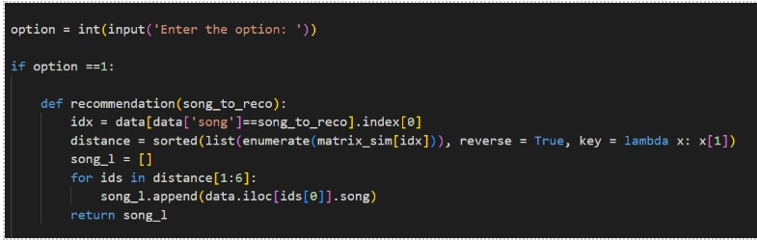
CODE

Slide 11
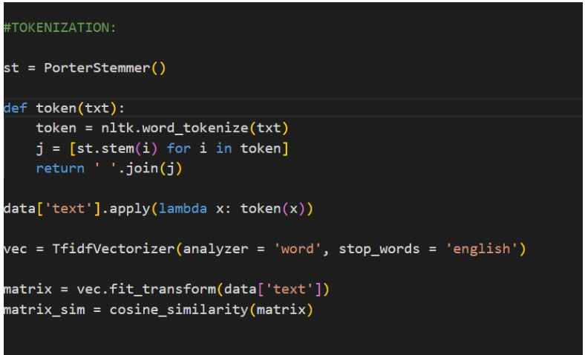

Slide 12

Tokenization
The process of tokenizing text or a string of letters involves dividing them into smaller pieces, usually words or subwords, known as tokens. The fundamental building blocks for a variety of natural language processing (NLP) activities are these tokens.
Tokenization is a crucial preprocessing step in NLP that gets textual input ready for analysis. Key objectives of tokenization consist of:
Breaking Text into Tokens: Depending on the amount of granularity needed for the task, breaking text into discrete units such as words, subwords, or even characters.
Text normalisation :process of standardising or normalising text by managing contractions, eliminating punctuation, changing all words to lowercase, and carrying out other changes to make text consistent.
Preparation for Analysis: Offering an organised framework for additional analysis, including named entity analysis, sentiment analysis, and language modelling

Slide 13
COSINE SIMILARITY-
It assess the similarity between documents represented as numerical vectors in a high-dimensional space. It's calculated by taking the dot product of the vectors and dividing it by the product of their magnitudes, yielding a value between -1 and 1. A value of 1 signifies perfect similarity, while 0 indicates no similarity, and -1 implies perfect dissimilarity. In our project it is used in comparing the lyrics to get desirable results .

Slide 14

CHALLENGES AND FUTURE DECISIONS
Challenges include feature selection, scalability with large music databases, dealing with diverse user tastes, addressing the cold-start problem for new users or items, and continuous model adaptation
Future objectives include utilising complex machine learning and AI techniques such as deep learning, improving user modelling with context-aware recommendations, and investigating creative data forms.

Slide 15

RESEARCH PAPERS
Peter J Rentfrow and Samuel D Gosling. Message in a Ballad: the Role of Music Preferences in Interpersonal Perception. Psychological science, 17(3):236–42,
March 2006
Peter J. Rentfrow and Samuel D. Gosling. The Do Re Mi’s of Everyday Life: The
structure and personality correlates of music preferences. Journal of Personality
and Social Psychology, 84(6):1236–1256, 2003.
S Gosling. A Very Brief Measure of the Big-Five Personality Domains. Journal of
Research in Personality, 37(6):504–528, December 2003.

Slide 16
REFERENCES
– K-means clustering with Earth-Mover’s Distance: It computes a general distance between Gaussian Mixture Models (GMM) by combining individual distance between gaussian components [62].
– Expectation-Maximization with Monte Carlo Sampling: This measurement makes use of vectors sampled directly from the GMMs of the two
songs to be compared; the sampling is performed computationally via random number generation [51].
– Average Feature Vectors with Euclidean Distance: It calculates loworder statistics such as mean and variance over segments [16].
A Survey of Music Recommendation Systems and Future Perspectives Yading Song, Simon Dixon, and Marcus Pearce

Slide 17
MODULES USED
Panda (helps to load the data frame in a 2D array format and has multiple functions to perform analysis tasks in one go.)
Nltk ( )
Sklearn (contains multiple libraries having pre-implemented functions to perform tasks from data preprocessing to model development and evaluation.)

